Slide 1
JPEG Compression
CMPUT 206: Introduction to Digital Image Processing
Instructor: Nilanjan Ray
Sources: (1) https://en.wikipedia.org/wiki/JPEG, (2) https://www.ijg.org/files/Wallace.JPEG.pdf
(3) Graduate Institute of Communication Engineering, National Taiwan University, Taipei, Taiwan, ROC

Slide 2
Agenda
Illustration of JPEG (Joint Photographic Expert Group) compression algorithm
We will discuss the “baseline” compression pipeline

Slide 3
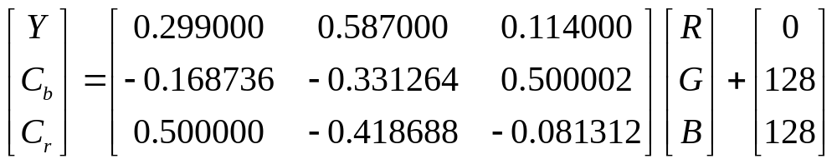
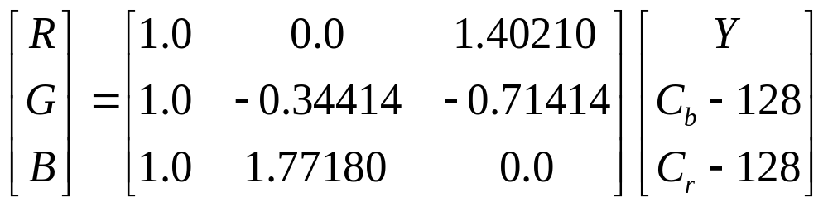
Color Conversion

Slide 4
Downsampling of Color Channels
W
W/2
W/2
Y
H
C_{b}
H/2
C_{r}
H/2
C_{b} and C_{r} channels are downsampled

Slide 5
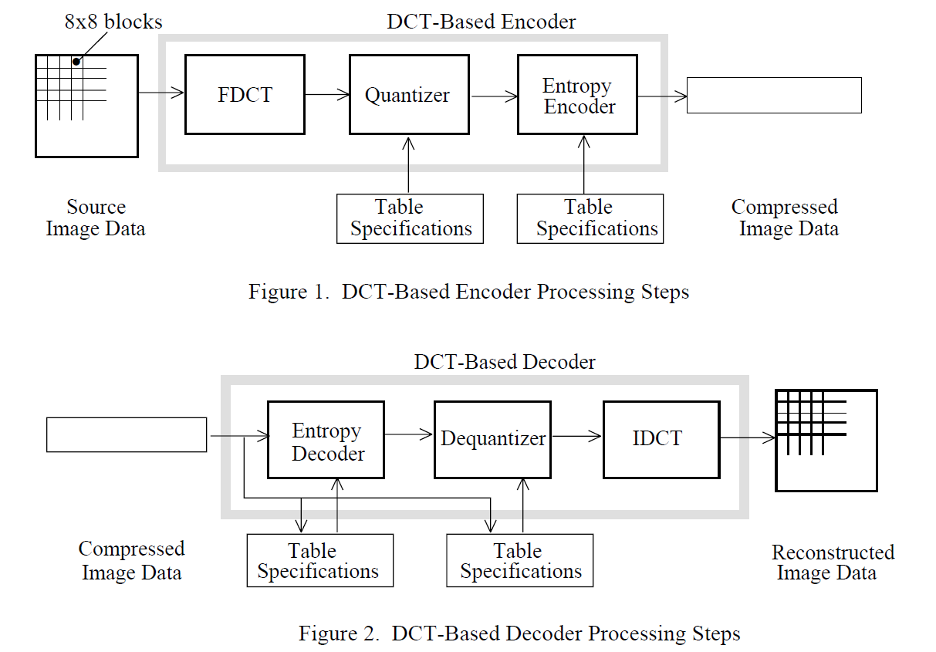
Encoding/Decoding Pipeline

Slide 6
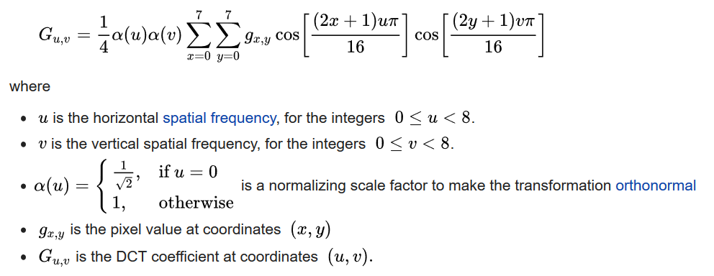
Discrete Cosine Transform

Slide 7
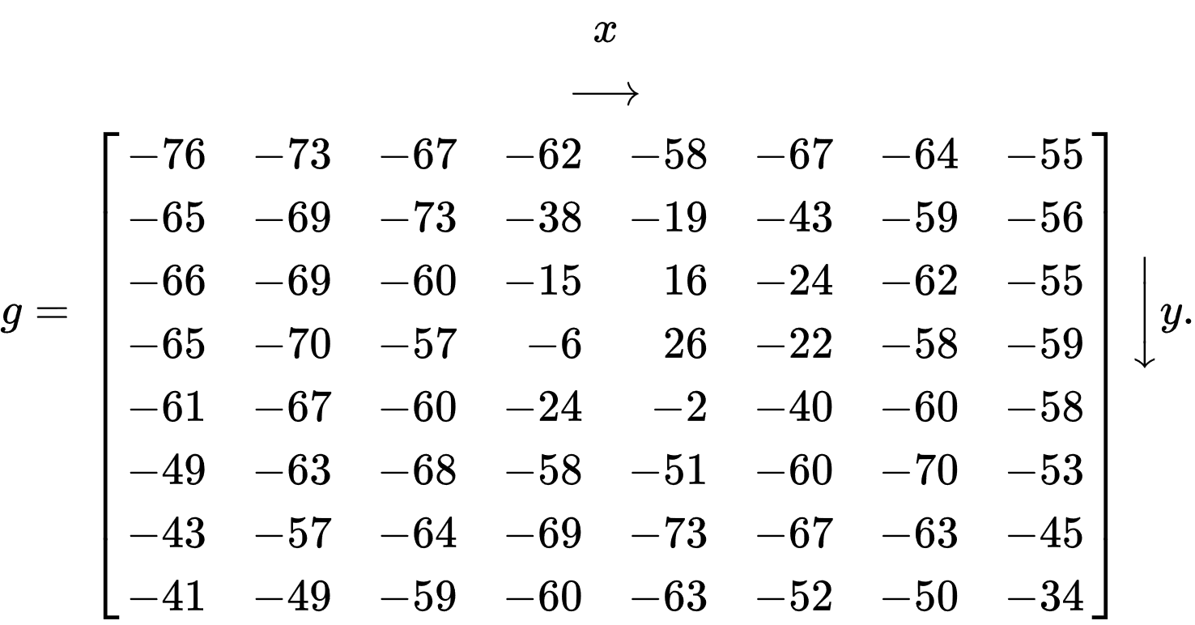
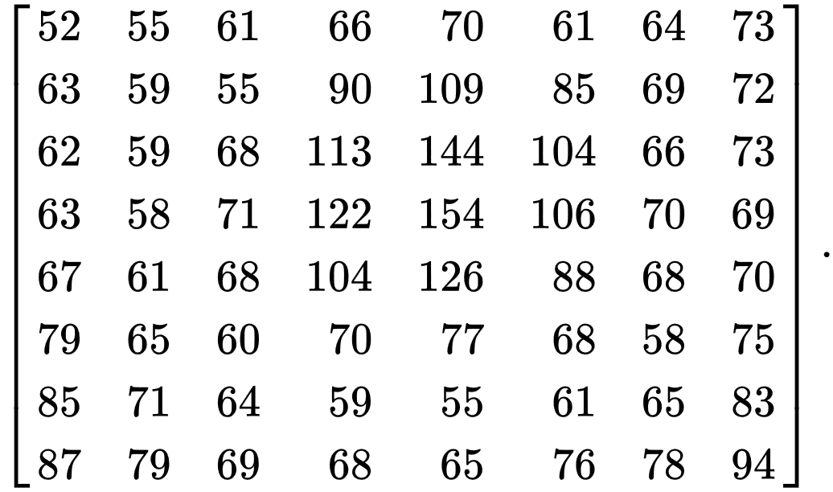
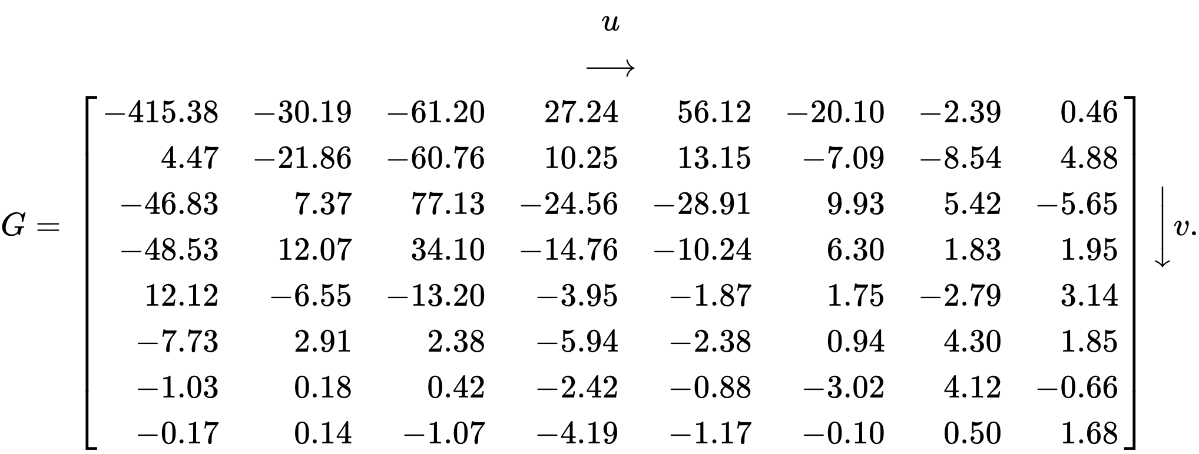
Example DCT
After centering
8-by-8 block
After DCT

Slide 8
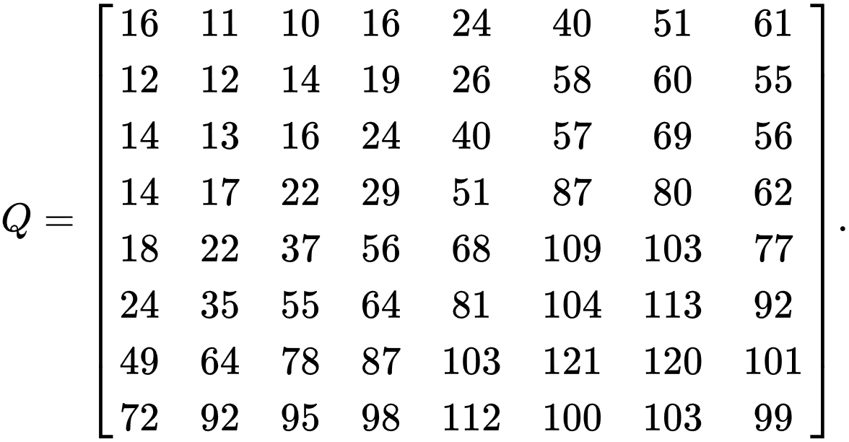
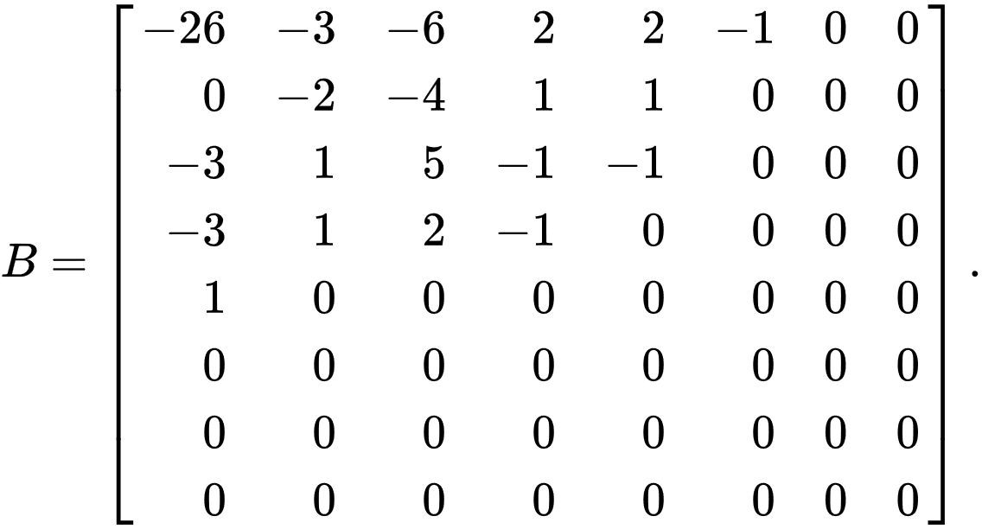
Example Quantization
B = round (G/Q)
Quantization table
Quantized 8-by-8 block

Slide 9
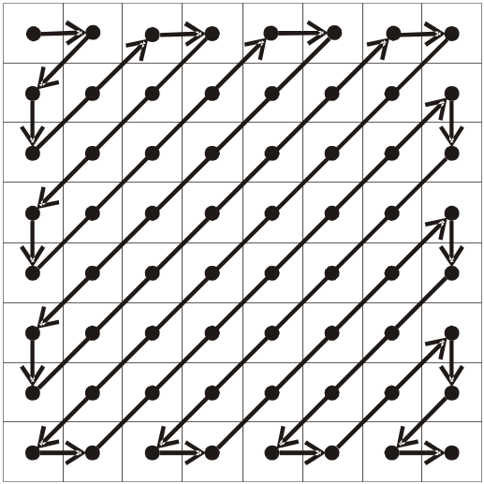
Zig-Zag Reordering
DC
0 | 1 | 5 | 6 | 14 | 15 | 27 | 28
2 | 4 | 7 | 13 | 16 | 26 | 29 | 42
3 | 8 | 12 | 17 | 25 | 30 | 41 | 43
9 | 11 | 18 | 24 | 31 | 40 | 44 | 53
10 | 19 | 23 | 32 | 39 | 45 | 52 | 54
20 | 22 | 33 | 38 | 46 | 51 | 55 | 60
21 | 34 | 37 | 47 | 50 | 56 | 59 | 61
35 | 36 | 48 | 49 | 57 | 58 | 62 | 63
Quantized block will be reordered
1 DC value, 63 AC values

Slide 10
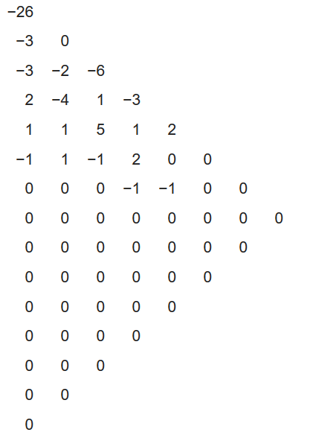
Example Reordering

Slide 11
Run Length Coding
Example 1
63 AC coefficience:
57, 45, 0, 0, 0, 0, 23, 0, -30, -16, 0, 0, 1, 0, 0, 0, 0, 0, 0, 0,..., 0
Run Length Coding :
(0,57) ; (0,45) ; (4,23) ; (1,-30) ; (0,-16) ; (2,1) ; EOB
Example 2
63 AC coefficience:
57, 0, 0, ... , 0, 3, 0, 0, 0, 0, 2, 0, 0, ... , 0, 895, EOB
Run Length Coding :
(0,57) ; (15,0) ; (2,3) ; (4,2) ; (15,0) ; (15,0) ; (1,895) ; (0,0)
50 zeros
(0,0)
18 zeros
33 zeros

Slide 12
Difference Coding
Encode :
Diff_{i} = DC_{i} − DC_{i−1}
Decode :
DC_{i} = DC_{i−1} + Diff_{i}
Diff_{i−1}=
DC_{i−1} −DC_{i−2}
Diff_{i}=
DC_{i} −DC_{i−1}
Diff₁=DC₁
DC₀
DC₁
…
DC_{i−1}
DC_{i}
…
0
…
…
block 1
block i−1
block i

Slide 13
Huffman (Entropy) Coding
Category | Values | Bits for the value
1 | -1,1 | 0,1
2 | -3,-2,2,3 | 00,01,10,11
3 | -7,-6,-5,-4,4,5,6,7 | 000,001,010,011,100,101,110,111
4 | -15,...,-8,8,...,15 | 0000,...,0111,1000,...,1111
5 | -31,...,-16,16,...31 | 00000,...,01111,10000,...,11111
6 | -63,...,-32,32,...63 | 000000,...,011111,100000,...,111111
7 | -127,...,-64,64,...,127 | 0000000,...,0111111,1000000,...,1111111
8 | -255,..,-128,128,..,255 | ...
9 | -511,..,-256,256,..,511 | ...
10 | -1023,..,-512,512,..,1023 | ...
11 | -2047,..,-1024,1024,..,2047 | ...

Slide 14
Huffman Coding Example
Example
Run length coding of 63 AC coefficients:
(0,57) ; (0,45) ; (4,23) ; (1,-30) ; (0,-8) ; (2,1) ; (0,0)
Encode the right value of these pair as category and bits for the value, except the special markers like (0,0) or (15,0) :
(0,6,111001) ; (0,6,101101) ; (4,5,10111);
(1,5,00001) ; (0,4,0111) ; (2,1,1) ; (0,0)
The difference of DC coefficients :
-511
Encode the value as category and bits for the value :
9, 000000000

Slide 15
Huffman Coding of AC
run/category | code length | code word
0/0 | 4 | 1010
...
0/6 | 7 | 1111000
...
0/10 | 16 | 1111111110000011
1/1 | 4 | 1100
...
1/5 | 11 | 11111110110
...
4/5 | 16 | 1111111110011000
...
15/10 | 16 | 1111111111111110

Slide 16
Huffman Coding of DC
category | code length | code word
0 | 2 | 00
1 | 3 | 010
2 | 3 | 011
3 | 3 | 100
4 | 3 | 101
5 | 3 | 110
6 | 4 | 1110
7 | 5 | 11110
8 | 6 | 111110
9 | 7 | 1111110
10 | 8 | 11111110
11 | 9 | 111111110

Slide 17
AC Huffman Coding Example
Example
The AC coefficiences :
(0,6,111001) ; (0,6,101101) ; (4,5,10111);
(1,5,00001) ; (0,4,0111) ; (2,1,1) ; (0,0)
Encode the left two value in () using Huffman encoding :
1111000 111001 , 1111000 101101 , 1111111110011000 10111 ,
11111110110 00001 , 1011 0111 , 11100 1 , 1010
The DC coefficience :
9, 000000000
Encode the category using Huffman encoding :
1111110 000000000

